Slide 1

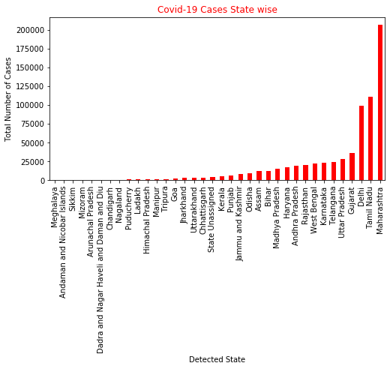
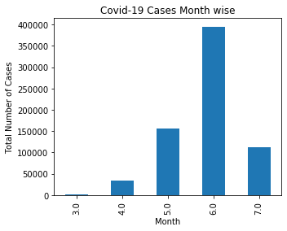
Major Project
A. Present state analytics – India

Slide 2

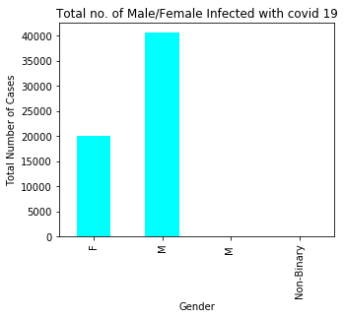
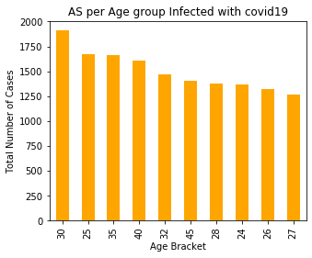
Major Project
A. Present state analytics – India

Slide 3
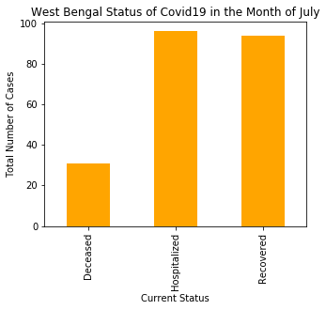
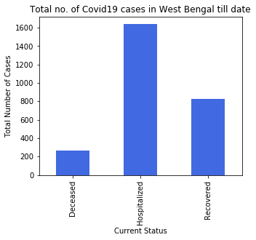
Major Project
A. Present state analytics – West Bengal

Slide 4
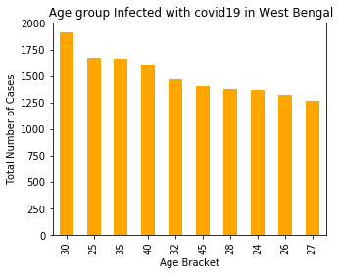
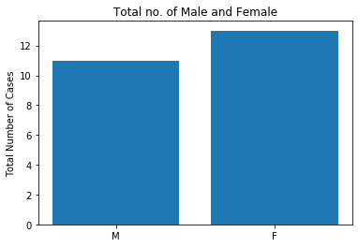
Major Project
A. Present state analytics – West Bengal

Slide 5
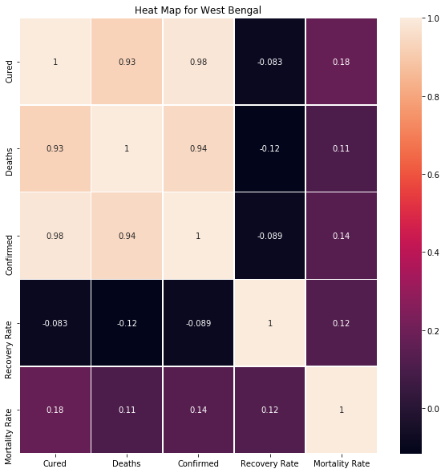
Major Project
B. Heat Map :West Bengal

Slide 6
Thanks..
Pooja Rana
Reg.No. H12129

Slide 7
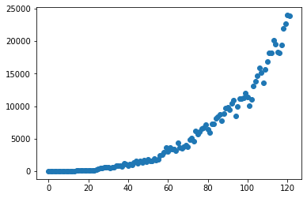
Major Project
C. Build a model for predicting the confirmed and recovered on any dates past 15th July 2020.
Linear Regression

